Slide 1
YouTube Data Harvesting and Warehousing using SQL and Streamlit
Presented By
Janani J

Slide 2
Technical Skills
1.Python scripting
2.Data Collection
3.Streamlit
4.API integration
5.Data Management using
MongoDB
SQL

Slide 3
ABSTRACT
To create a Streamlit application that allows users to access and analyze data from multiple YouTube channels.

Slide 4
Application should have the following features:
Ability to input a YouTube channel ID and retrieve all the relevant data (Channel name, subscribers, total video count, playlist ID, video ID, likes, dislikes, comments of each video) using Google API.
Ability to collect data for up to 10 different YouTube channels and store them in the data lake by clicking a button.
Option to store the data in a MYSQL or PostgreSQL.
Ability to search and retrieve data from the SQL database using different search options, including joining tables to get channel details.

Slide 5
Approach:
Set up a Streamlit app
Connect to the YouTube AP
Store and Clean data
Migrate data to a SQL data warehouse
Query the SQL data warehouse
Display data in the Streamlit app

Slide 6
PYTHON
Python is a popular programming language. It was created by Guido van Rossum, and released in 1991
It is used for:
web development (server-side),
software development,
mathematics,
system scripting.

Slide 7
SQL
SQL stands for Structured Query Language
SQL lets access and manipulate databases
SQL storing, manipulating and retrieving data in databases

Slide 8
PANDAS
Pandas is a Python library used for working with data sets.
It has functions for analyzing
cleaning
exploring
manipulating data.

Slide 9
MONGODB
MongoDB is a document database and can be installed locally or hosted in the cloud
To use MongoDB Atlas, a cloud database platform.
This is much easier than hosting your own local database.

Slide 10
STREAMLIT
Streamlit is an open source python frame work
To develop only few lines of code
Build and deploy powerful data apps in minutes

Slide 11
IMPORTED LIBRARIES
from googleapiclient.discovery import build
import googleapiclient.discovery
import pymongo
import mysql.connector
import streamlit as st
import pandas as pd
from datetime import datetime

Slide 12
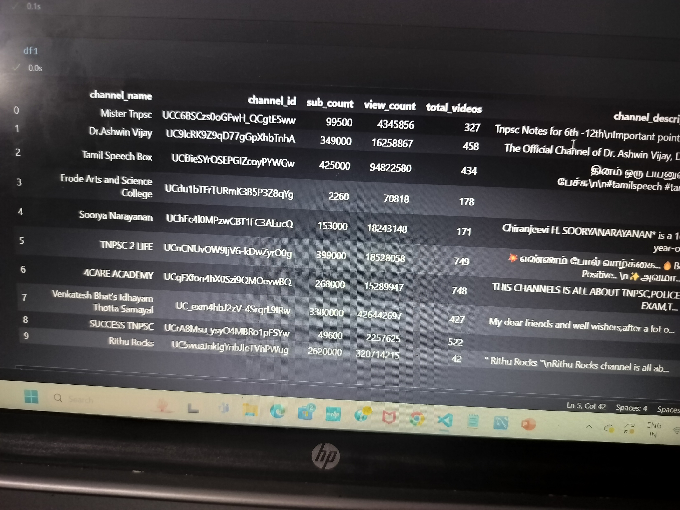
DATAFRAME CREATION

Slide 13
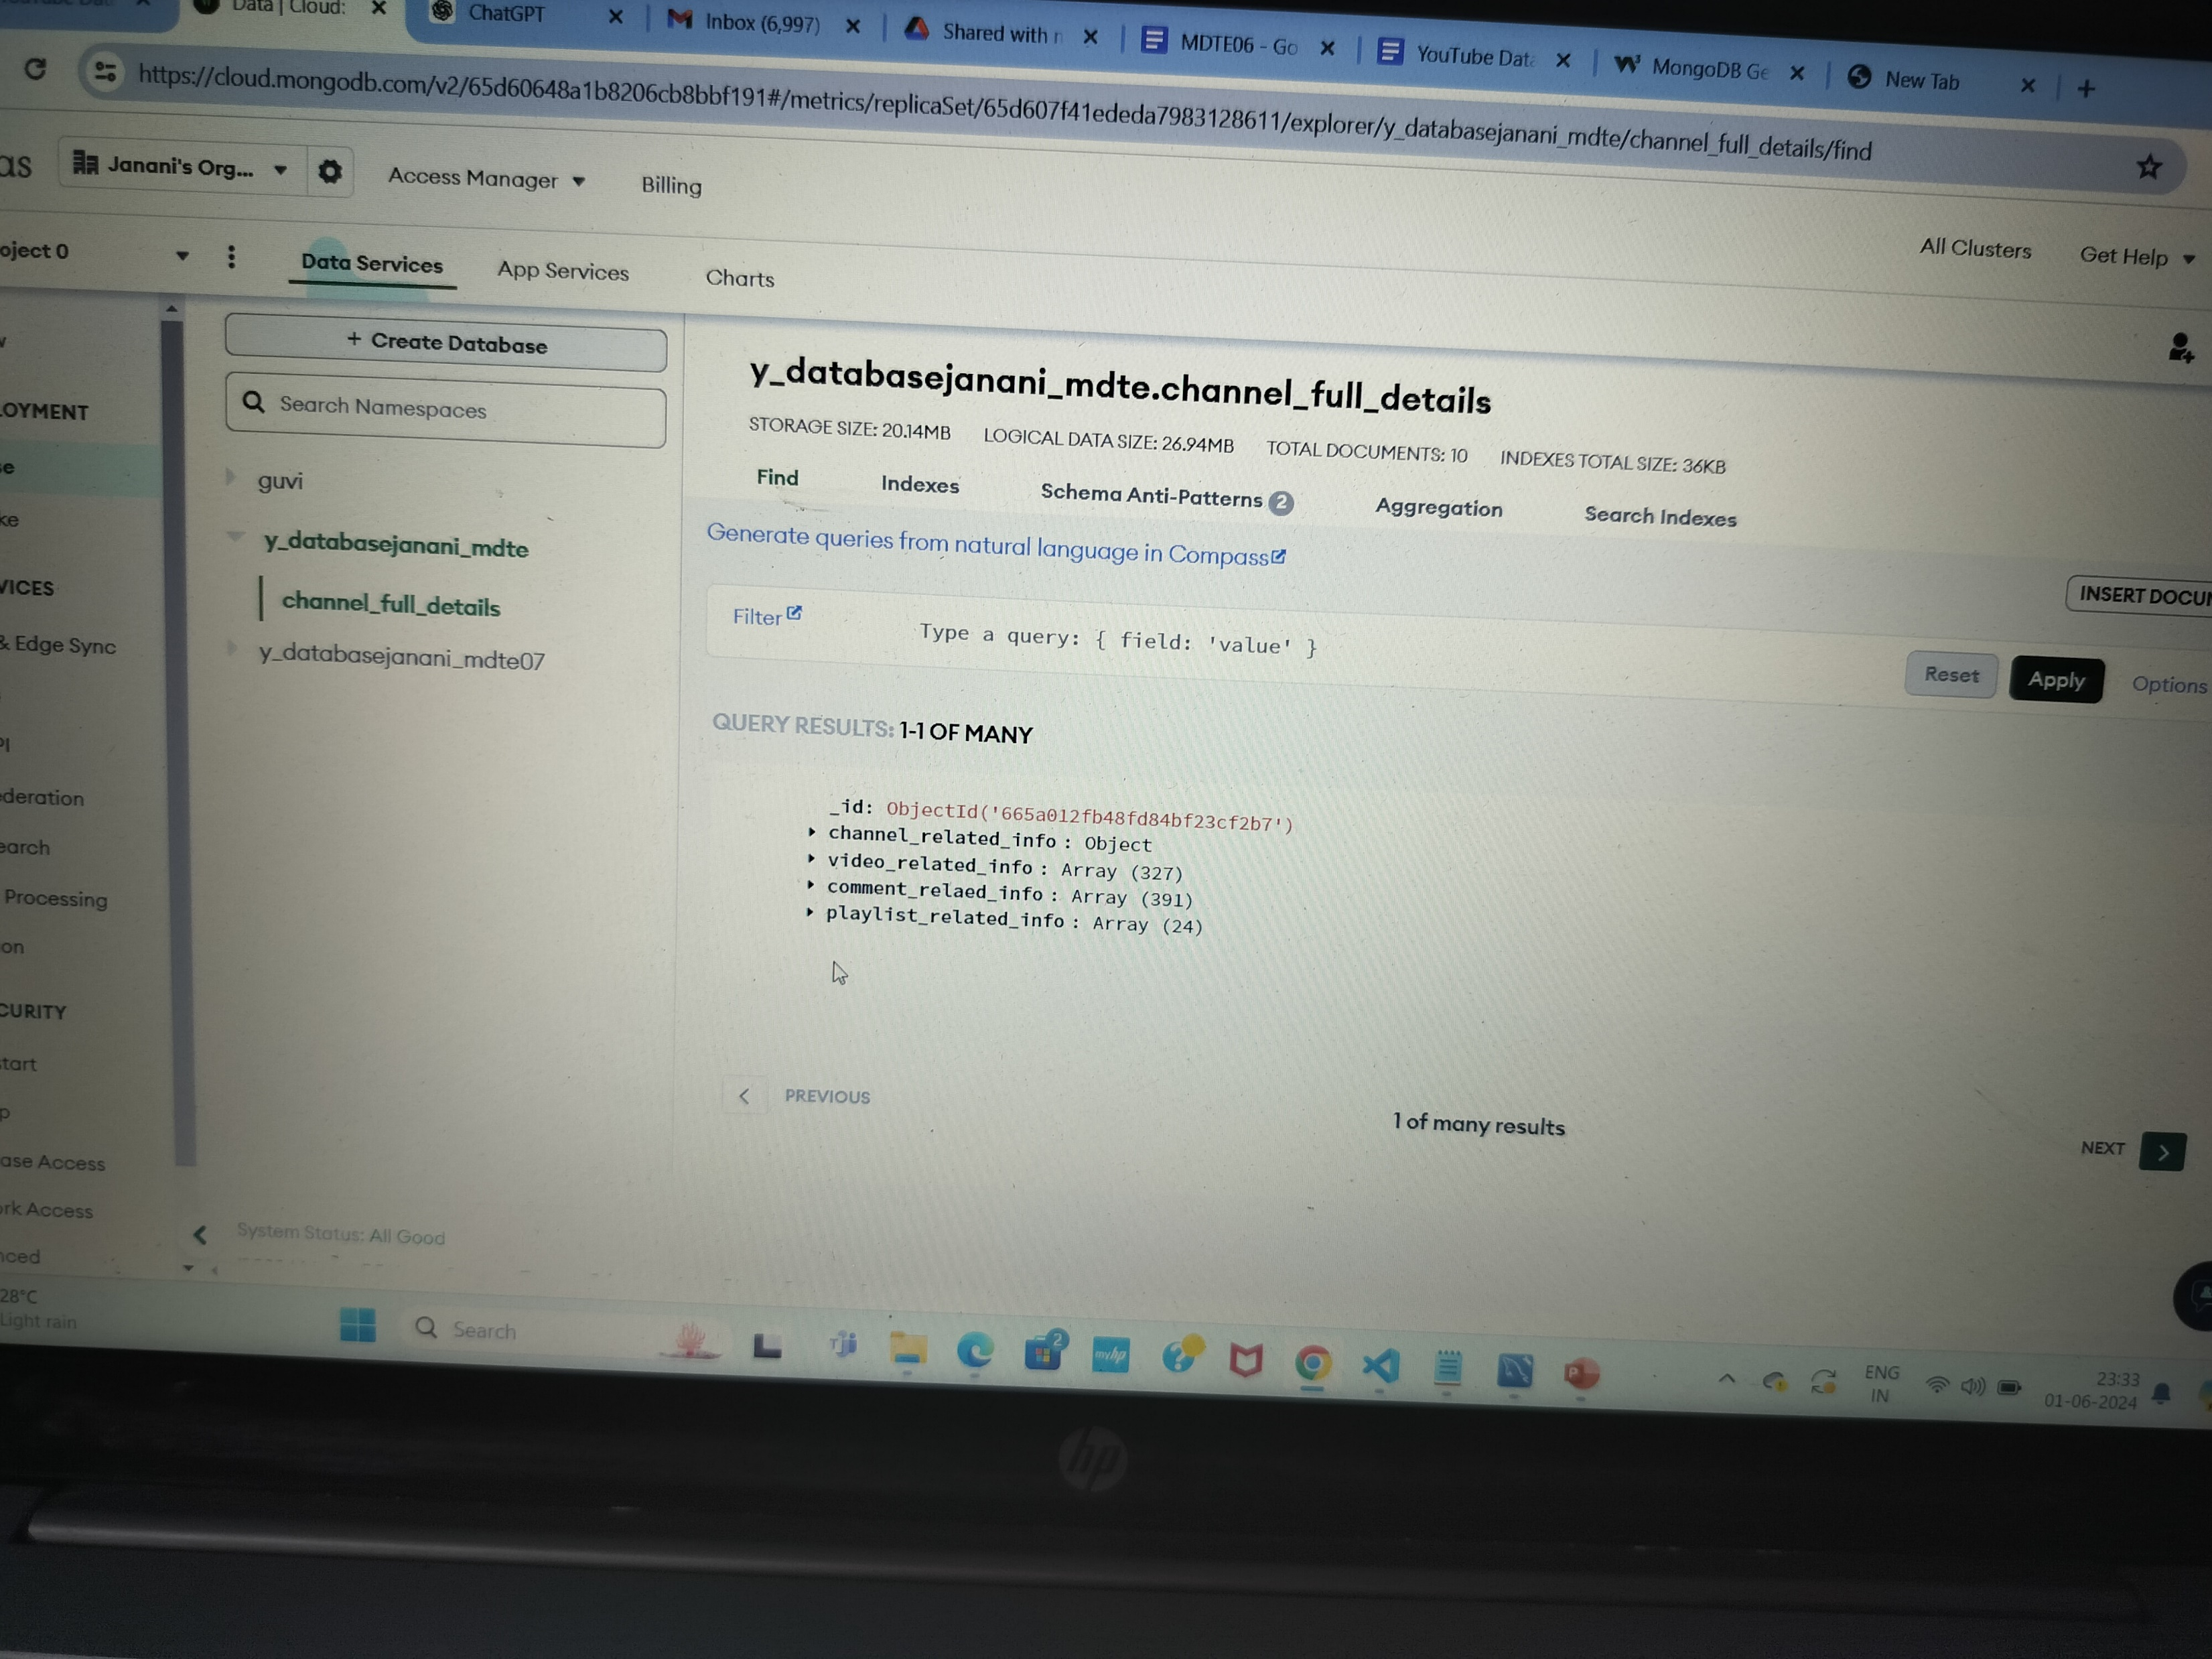
MONGODB COLLECTIONS

Slide 14
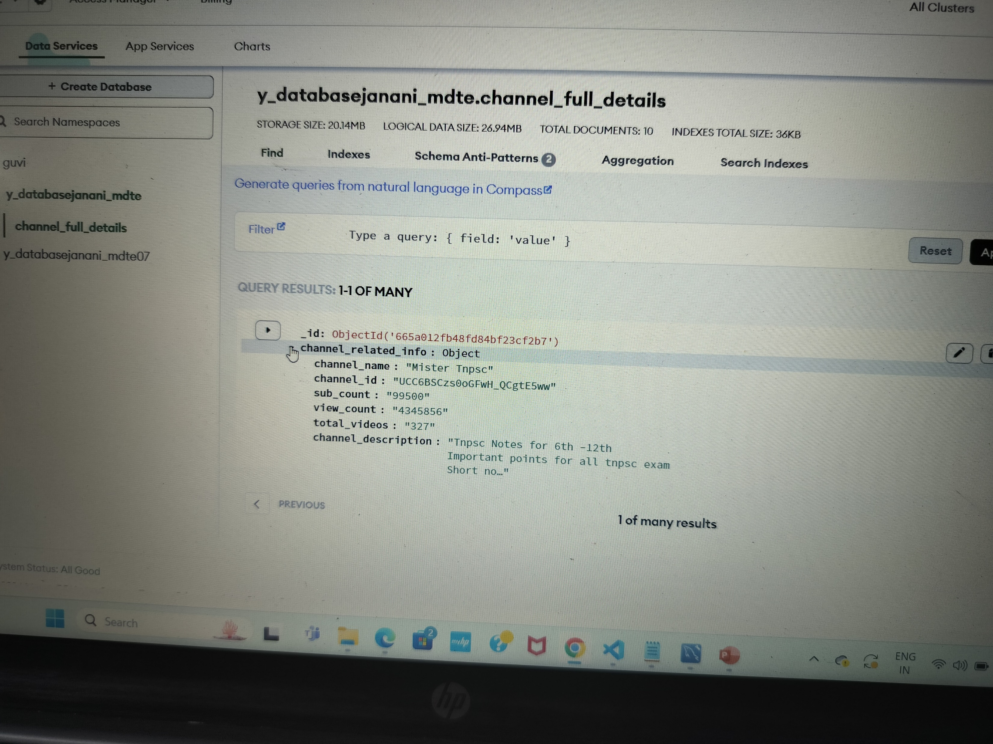
MONGODB DOCUMENT CREATION

Slide 15
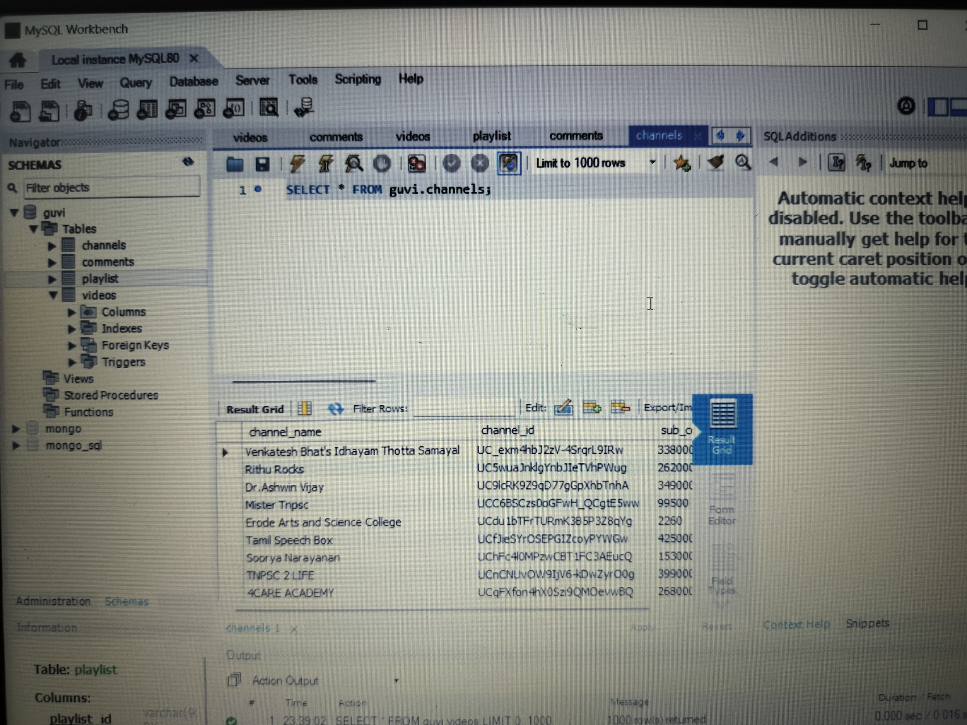
TABLE CREATION IN SQL

Slide 16
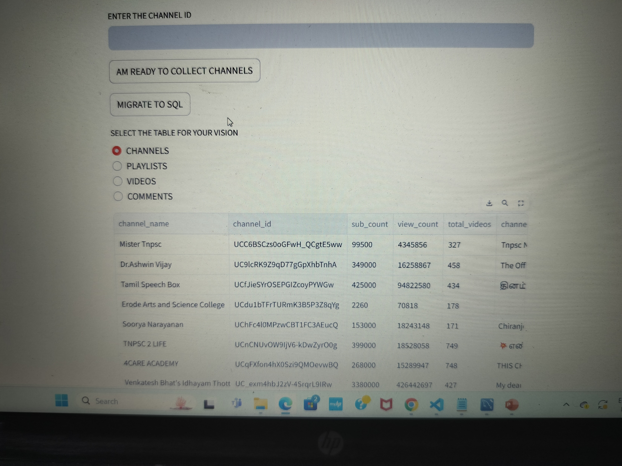
MODEL OUTPUT

Slide 17
SQL Query Output need to displayed as table in Streamlit Application:
What are the names of all the videos and their corresponding channels?
Which channels have the most number of videos, and how many videos do
they have?
What are the top 10 most viewed videos and their respective channels?
How many comments were made on each video, and what are their
corresponding video names?
Which videos have the highest number of likes, and what are their
corresponding channel names?

Slide 18
Continue…..
6.What is the total number of likes and dislikes for each video, and what are
their corresponding video names?
7.What is the total number of views for each channel, and what are their
corresponding channel names?
8.What are the names of all the channels that have published videos in the year
2022?
9.What is the average duration of all videos in each channel, and what are their
corresponding channel names?
10Which videos have the highest number of comments, and what are their
corresponding channel names?

Slide 19
Results
This project aims to develop a user-friendly Streamlit application that utilizes the Google API to extract information on a YouTube channel, stores it in a SQL database, and enables users to search for channel details and join tables to view data in the Streamlit app

